Slide 1
Java Programming: From the Ground Up
Lecture 22
Chapter 16 – Part 2
Data Structures and Generics

Slide 2
Data Structures
Understand elementary data structures:
Array
ArrayList
Stack
Queue
Linked List

Slide 3
Queue
A queue is an ordered list of data into which data can be inserted and removed. However, unlike a stack, data is always inserted at one end of a queue, the rear, and removed from the other end, the front.
Typical queue operations include:
insert: add an item to the rear of the queue.
remove: remove and return an item from the front of the
queue.
peek: view or “peek at” the front item.
empty: determine whether or not there are any elements
in the queue.
size: get the number of elements stored in the queue

Slide 4
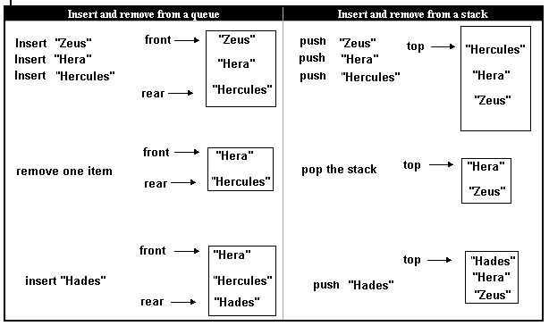
Queue vs. Stack

Slide 5
Queue ADT
The queue operations are specified the following generic interface:
public interface QueueInterface<E>
{
public void insert(E x);
// inserts x at the rear of the queue
public E remove();
// removes and returns the front item
// returns null if the queue is empty
public boolean empty();
// returns true if no elements are in the queue
public E peek();
// returns the front item, does not alter the queue
// returns null if the queue is empty
public int size();
// returns the number of items in the queue
}

Slide 6
Queue Implementation
We can implement a queue using an ArrayList<E> for storage. However,
this is not the most expedient implementation.
Suppose, for example, that items is an ArrayList<E> and that items holds queue elements. The insert() operation can be implemented as:
void insert(E x)
{
items.add(x): }
which places element x at the end of items.
The method is easy and efficient.

Slide 7
Queue Implementation
On the other hand, the remove() operation, although easy to implement, is not particularly efficient. If the first queue element is always located at position 0, the remove operation can be implemented as:
E remove()
{
if (empty())
return null;
return items.remove(0);
}
The method works correctly but at a cost. When the element at position 0 is deleted from an ArrayList<E> object, all other elements in the list are shifted. That is, the element in position 1 is moved to position 0, the element in position 2 is moved to position 1 etc. So every remove() operation necessitates that all remaining elements in items are moved

Slide 8
Queue Implementation
A queue can be more efficiently implemented using a simple array for storage. The only real limitation with such an implementation is that the size of an array is fixed. However, if you can estimate the maximum size of a queue, an array implementation is a good option.

Slide 9
Queue Implementation
A queue that uses an array, items, with maximum capacity 5.
The variable front holds the index of the first item in the queue and a second
variable rear holds the index of the last item in the queue.
The queue after four insert operations;
after two remove operations , and
after one more insert operation.

Slide 10
Queue Implementation
. Will one more insert() operation throw an ArrayOutOfBoundsException? Not necessarily.
There are two available cells in the array: items[0] and items[1]. If the next insert operation, insert("Saturn"), places "Saturn" in items[0], then no error occurs. That is, we consider items[0] to be the cell that follows items[4]. In practice, we imagine the array as circular.

Slide 11
Queue Implementation
By using “circular array,” we do not waste any array locations, and the queue can hold as many elements as the size of the underlying array. Nevertheless, overflow errors can still occur once we use all the space in the array.

Slide 12
Queue Implementation
Problem Statement:
Implement a queue using an array for storage. The Queue<E> class should implement QueueInterface<E>.
Solution
The Queue<E> class uses an array, items for storage. There are also four integer fields:
front, which holds the index of the first item in the queue,
rear, which holds the index of the last item in the queue,
numItems, which stores the number of items in the queue, and
maxQueue, which stores the maximum capacity of the queue.
The array, items, is considered circular. This means that, if space remains, items[0] is the storage location following items[maxQueue-1], where maxQueue is items.length.
Because an array has a fixed size, it is possible to exceed the capacity of a queue. In this case, the insert() method issues a message and exits. Alternatively, insert() might throw an exception.

Slide 13
Queue Implementation
import java.util.*;
public class Queue<E> implements QueueInterface<E>
{
private E[] items;
private int numItems; // number of elements currently in the queue
int front, rear; // holds the indices of the front an rear elements
int maxQueue; // maximum capacity
public Queue() // default constructor, sets maxQueue to 10
{
items =(E[]) new Object[10]; // new E[10] is illegal; the cast is necessary
numItems= 0;
front = rear= -1; // -1 indicates that the queue is empty
maxQueue = 10;
}
public Queue(int max) // one argument constructor , accepts maximum capacity
{
maxQueue = max;
items =(E[]) new Object[maxQueue]; // new E[maxQueue] is illegal; the cast is necessary
numItems = 0;
front = rear= -1; // -1 indicates that the queue is empty
}

Slide 14
Queue Implementation
public void insert(E x)
// inserts x at the rear of the queue
// if overflow occurs, issues a message and exits
{
if ( numItems == maxQueue) // queue is full
{
System.out.println(" Queue Overflow");
System.exit(0);
}
rear = (rear +1) % maxQueue; // % maxQueue ensures wraparound
items[rear] = x;
numItems++;
if (numItems == 1) // if queue was previously empty
front = rear;
}

Slide 15
Queue Implementation
public E remove()
// removes and returns the first item in the queue
// if the queue is empty , returns null
{
if (numItems == 0) // empty queue
return null;
E temp = items[front]; // holds the first item in the queue
numItems--;
if ( numItems == 0) // if the queue is now empty set front and rear to –1
front = rear = -1;
else
front = (front + 1) % maxQueue; // %maxQueue ensures wraparound
return temp;
}
public E peek()
// returns the first item in the queue or null if the queue is empty, does not alter the queue
{
if (numItems == 0) // empty queue
return null;
else
return items[front];
}
public boolean empty()
// returns true if the queue is empty
{ return numItems == 0; }
public int size()
// returns the number of items currently in the queue
{ return numItems; }

Slide 16
Queue Implementation
Discussion
Lines 10 and 18: items =(E[]) new Object[10];
items =(E[]) new Object[maxQueue];
Java does not allow generic arrays. The statement
items = new E[10];
results in a compilation error. To avoid this error, we instantiate an array of Object and cast that to E[].
When the class is compiled the compiler issues a warning to the effect that the cast on lines 10 and 18 may be unsafe. However, no problem occurs here because every item in the queue belongs to the class represented by E.

Slide 17
Queue Implementation
Lines 31 and 48: rear = (rear +1) % maxQueue;
front = (front+1) % maxQueue;
These lines effect wraparound. For example, suppose that that maximum capacity of a queue is 10, and that the queue consists of three items stored at items[7], items[8], and item[9]. Since the value of rear is 9,
rear = (rear+1)% maxQueue = (9+1)% 10 = 0.
Thus, the next item is stored at items[0]. The array is circular; 0 follows 9.

Slide 18
Linked List
A linked list is an ordered collection, group, or list of items such that each item holds a reference or “link” to the next item of the collection.
To implement a linked list we use nodes
A node is an object that contains data as well as a reference to another node. Thus, a node has at least two fields, one of which holds the address of another node.

Slide 19

A Node class
public class Node
{
public String data;
public Node next;
// next is a reference to a Node
public Node () // default constructor
{
data = “”; // the empty string
next = null;
} // one argument constructor
public Node(String s)
{
data = s;
next = null;
}
}
The data type of next is Node.
The next field of a Node is itself a reference to a Node object.
The next field holds the address of another node.
Node is a recursive structure.

Slide 20
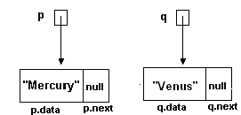
Node
The statements
Node p = new Node("Mercury"); // one-argument constructor
Node q = new Node ("Venus");
instantiate two Node objects, one referenced by p and another
referenced by q.

Slide 21
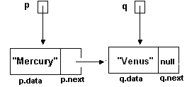
Node
Nodes can be linked together to form a “chain of nodes.”
The horizontal arrow indicates that the field p.next (in the “Mercury” node)
holds the address of the “Venus” node, which also happens to be stored in q.
The linking of these two nodes is accomplished by the statement
p.next = q; //q holds the address of the “Venus” node,
which assigns the address of the “Venus” node (q) to the next field of the
“Mercury” node (p.next).

Slide 22

Node
Four linked nodes

Slide 23
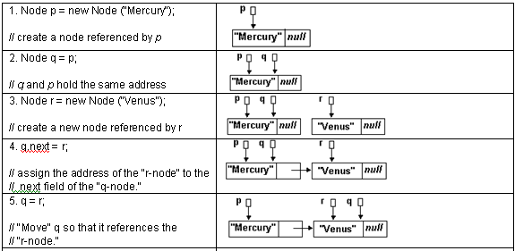
Creating a Chain of Nodes

Slide 24
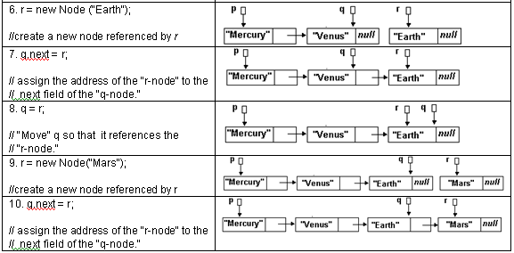
Creating a Chain of Nodes

Slide 25
Chain of Nodes
Problem Statement
Implement a class, Chain, that creates a chain of Node objects such that each Node holds a String entered via the console. Include a method that displays the data stored in the chain.
In the following application note that
a private Node class is declared within Chain; and
a reference front holds the address of the first node in the chain. Without such a reference, the data in the chain is inaccessible. The reference front serves as an anchor for the chain of nodes.

Slide 26
Chain of Nodes
import java.util.*;
public class Chain
{
private class Node // a class declared within Chain, an inner class
{
private String data;
private Node next;
public Node() // default constructor
{
data = “”;
next = null;
}
public Node(String s) // one argument constructor
{
data = s;
next = null;
}
}

Slide 27
Chain of Nodes
public Chain() // constructor builds a chain
{
Scanner input = new Scanner(System.in);
String name;
Node q, r;
System.out.print("Enter name -- Press <Enter> to signal end of data: " );
name = input. nextLine();
// create the first node
front = new Node(name);
q = front; // front and q both reference the first node
System.out.print("Enter name: " );
name = input. nextLine();
while (!name.equals(""))
{
r = new Node(name); // get a new node
q.next = r; // link the previous node to the new node
q = r; // move q to the "new" node
System.out.print("Enter name: " );
name = input. nextLine();
}

Slide 28
Chain of Nodes
public void printChain()
{
Node q = front; // q references the first node in the chain
System.out.println("\nThe names in the chain of nodes are: ");
while (q!= null)
{
System.out.println(q.data);
q = q.next; // move q to the next node in the chain
}
}
public static void main(String[] args)
{
Chain chain = new Chain();
chain.printChain();
}
}

Slide 29
Node, an inner class
Node is declared as a private class declared within another class, Chain. Node is declared solely for Chain’s convenience. Node is called an inner class and Chain, an outer or surrounding class.
Inner classes are useful when one class has meaning only in the context of another class. For example, on its own, a Node may have no apparent purpose, but a part of a chain, a Node object has a well-defined function.
The methods of an inner class have direct access to variables and methods of the surrounding outer class. On the other hand, the methods of an outer class can access an inner class field or invoke an inner class method only via an object of the inner class. For example, consider the following class definitions.

Slide 30
Linked List
Because each node in a chain holds the address of the next node, a chain of nodes suggests a natural storage structure for a linked list class, LList<E>. In addition to the instance variable front, which references the first node of the chain, LLInk<E> includes a field, rear, which holds the address of last node, and a third reference variable current, which can reference any node in the chain.

Slide 31
Linked List
The methods of LList<E> include methods for adding, removing, and retrieving data. That is, the methods of LList<E> mirror the methods of ArrayList<E>. These methods, common to ArrayList<E> and LList<E>, are grouped together in the following interface

Slide 32
ListInterface
public interface ListInterface<E>
{
void add(int index, E x);
// inserts x into position index
void add(E x);
// adds x to the end of the list
void clear();
// removes all objects from the list
boolean contains ( E x);
// returns true if x is a member of the list
E get(int index); // returns the Object at position index

Slide 33
ListInterface
boolean isEmpty(); // returns true if the list has no elements
boolean remove (E x);
// if x is a member of the list, removes the first occurrence of x from the
// list, shifts all elements
// and returns true; otherwise returns false.
E remove (int index);
// removes and returns the object x at position index;
// shifts all elements following x down one position
E set (int index, E x);
// replaces the object at index index with x; returns the replaced object.
int size();
// returns the number of objects currently in the list
}

Slide 34
Linked List
The LList<E> class not only implements ListInterface<E> but also provides three additional methods, not found in ArrayList<E>,
void reset(), sets current equal to front
boolean hasNext()
returns true if current.next is not null, i.e. if current is not equal to rear.
E next().
if current == null, reports an error and terminates the application; otherwise returns the data of the current node and moves current down the list, i.e. sets current equal to current.next.

Slide 35
LList<E>
public class LList <E> implements ListInterface<E>
{
private class Node // an inner class
{
private E data;
private Node next;
public Node() // default constructor
{
data = null;
next = null;
}
public Node(E x) // two argument constructor
{
data = x;
next = null;
}
} // end

Slide 36
LList<E>
private Node front, rear, current;
private int length; // the size of the list
public LList() // default constructor
{
rear = front = current= null;
length = 0;
}
public void add(E x) // adds x to the end of the list
{
Node p = new Node(x); // instantiate a new node referenced by p
if (rear == null) // if list is initially empty
front =rear = p; // the list has just one node
else
{
rear.next = p; // places the Node referenced by p at the end
rear = p;
}
length++;
}

Slide 37
LList<E>
public void add(int index, E x) // adds x to list at position index
{
if (index > length ) // index out of range
{
System.out.println("Out of range in add(int index, E x)");
System.exit(0);
}
Node p = new Node(x); // instantiate a new node referenced by p
// add to the front of the list
if (index == 0)
{
p.next = front; // place the address of the first nod into the new node
front = p; // front references the new node
if (rear == null) // if list was initially empty
rear = front; // front and rear reference the single node of the list
length++;
return;
}

Slide 38
LList<E>
// add to the end of the list
if (index == length)
{
add(x);
return;
}
// addition is neither at front nor rear
Node q = front;
for (int i = 0; i < index-1; i++) // point q to the node at position index
q = q.next;
Node r = q.next; // r references the node following q (could be null)
q.next = p;
p.next = r;
length++;
}
public void clear() // makes the list empty
{
front = rear = null;
length = 0;
}

Slide 39
Llist<E>
public boolean contains (E x) // returns true if x is a member of the list
{
Node p = front;
for (int i = 0; i < length; i++) // could also use “(while p.next != null)”
{
if ( x.equals(p.data))
return true;
p = p.next;
}
return false; // search unsuccessful
}
public E get (int index) // returns data at position index
{
if (index >= length) // if index is out of bounds
{
System.out.println("Error in get (int index)");
System.exit(0);
}
Node p = front;
for (int i = 0 ; i < index; i++)
p = p.next; // move through the list, node by node
return p.data;
}

Slide 40
LList<E>
public boolean isEmpty() // returns true if list is empty
{
return length == 0;
}
public boolean remove (E x) // removes first occurrence of x;
// returns true if successful
{
Node p = front;
Node q = null;
while (!(p == null) && !x.equals(p.data)) // look for x
{
q = p;
p = p.next;
}
if (p == null) // not found
return false;
if (!(q == null)) // if x is in the first node q is null
q.next = p.next;
if (p == front)
front= front.next;
if ( p == rear)
rear = q;
length--;
return true;
}

Slide 41
LList<E>
public E remove (int index) // removes and returns data at position index
{
if (index >= length) // index out of bounds
{
System.out.println("Error in remove (int index)");
System.exit(0);
}
Node p = front;
Node q = null;
for ( int i = 0; i < index; i++) // q follows p down the list
{
q = p;
p = p.next;
}
if ( current ==p) // if removing the current node, move current to the next node
current = p.next;
if (!(q == null)) // if not removing the first node
// q follows p, so q is null when p is the first node.
q.next = p.next;
if (p == front)
front= front.next;
if ( p == rear)
rear = q;
length--;
return p.data;
}

Slide 42
LList<E>
public E set (int index, E x) // sets data at position index to x
{
if (index >= length) // index out of bounds
{
System.out.println("Error in get (int index)");
System.exit(0);
}
Node p = front;
for ( int i = 0; i < index; i++)
p = p.next;
E temp = p.data;
p.data = x;
return temp;
}
public int size() // returns the number of data on the list
{
return length;
}

Slide 43
LList<E>
public void reset() // makes the first node the current node
{
current = front;
}
public boolean hasNext() // returns true if a call to next() will be successful
{
if (current == null)
return false;
return true;
}
public E next() // returns data of current node and moves current to the next node
{
if (current == null)
{
System.out.println("Error in hasNext() ");
System.exit(0);
}
E temp = current.data;
current = current.next;
return temp;
}
}

Slide 44
Lines 25- 36: void add(E x)
This method adds a node with data x to the rear of the list.
Suppose that a list consists of three nodes:
The method call add(8) results in the following actions.

Slide 45
Lines 25- 36: void add(E x)
Line 27: Node p = new Node(8);
Line 33: rear.next = p;
Line 33: rear = p;

Slide 46
Lines 123- 148: E remove(int index)
This method removes the node at a given index. For example, remove(0) removes the first node in the list and remove(2) removes the third node in the list.
Trace a call to remove(2).

Slide 47
Lines 123- 148: E remove(int index)
Lines 132-136: for ( int i = 0; i < index; i++) { q = p; p = p.next; }
For i = 0 and i = 1,
set q equal to p, and
move p down the list.
Notice that q follows p.

Slide 48
Lines 123- 148: E remove(int index)
Lines 137-138: if ( current ==p) current = p.next;
p references the node which is to be removed. If current references the same node as p, move current down the list

Slide 49
Lines 123- 148: E remove(int index)
Lines 139-141: if (!(q == null)) q.next = p.next;
If q is null, then the node to be removed is the first node on the list.
In thiscase, q is not null. Here, p holds the address of the node that is to be
removed and q the address of the preceding node. Change the link in
q.next from p to p.next.

